Slide 1
Library Innovation and pivoting during covid-19
Discussion Presentation with Public Libraries
September 23, 2020
With Sarah Post, Cornerstones of Science
Betta Stothart, Cornerstones of Science
Amy Hand, Camden Public Library, Camden, ME
Adam Pitts, Gwinnett County Public Library, Lawrenceville, GA

Slide 2
Webinar Housekeeping
This session is being recorded and will be available upon request and added to our cornerstonesofscience.org website
Place yourselves on mute during presentations, but unmute yourselves when you want to speak for the discussion
If you don’t want to be recorded and you have a question, use the chat function and the co-host will read your question

Slide 3
Agenda for the Webinar
Brief background on Cornerstones of Science
Discussion on library innovation and pivoting during COVID-19 with a focus on programming
Presentation by Amy Hand, Children’s Librarian, Camden Public Library, ME
Discussion
Presentation by Adam Pitts, Gwinnett Public Library, Lawrenceville, GA
Discussion
Safety with Programming at the Library
Resources

Slide 4
Cornerstones Of Science (CoS) Mission – TO BRING SCIENCE TO THE COMMUNITY through the public library system
Circulating Science Trunks and science kits for projects
Flagship program is the CoS Library Telescope program
Professional development for library staff
Annual STEM conference for Maine Libraries, webinars, in-person trainings for NASA@ My Library project
Online STEM resources and content
STEMlibraries.org
Revupthefun.org
New initiatives during COVID-19
CoS Safe and Sane Star Party TM
Revupthefun.org

Slide 5
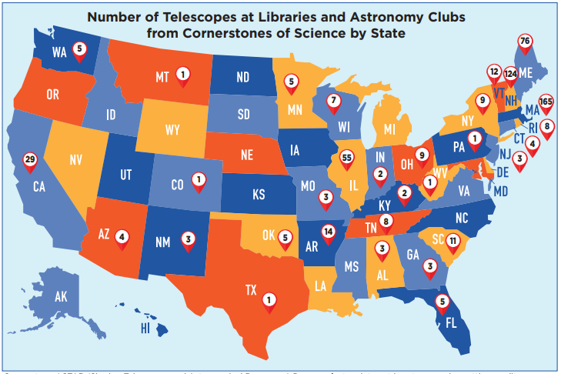
Cornerstones’ STAR (Sharing Telescopes and Astronomical Resources) Program fosters interest in astronomy by getting quality telescopes into the hands of the public. Checking out the telescope as they would a book, people can explore the wonders of the night sky at home. The STAR Program is an accessible way to make hands-on science fun and give people a greater appreciation for astronomy.

Slide 6
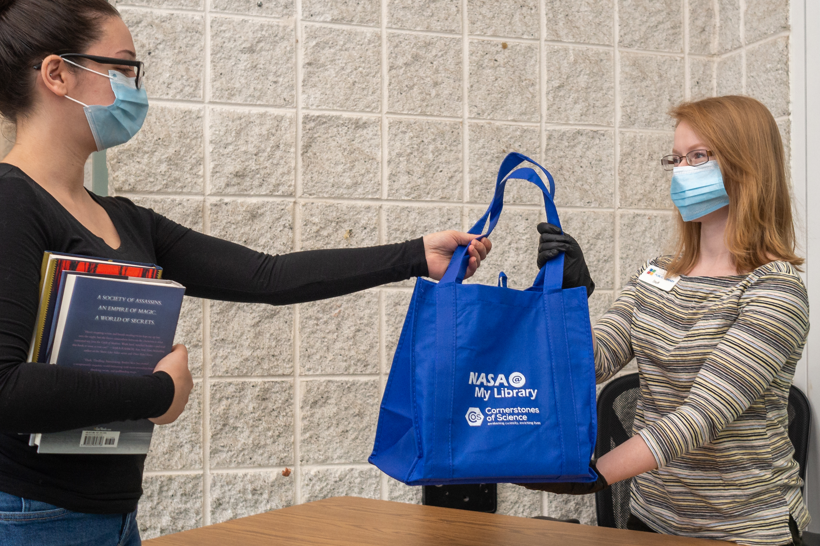
Innovation and Pivoting- at the library and with Library Programs
At the Library in general
Online/virtual
Curbside
Limited in-person
Other?
Programs
Take & Make bags (Grab & Go)
Videos/FB Live
Storytime Walks
Outdoor drive-thru events
Interactive Movie Experiences
Window displays
Missions and Badging
Virtual Trivia
Escape rooms at home
Other?

Slide 7
Presentation Innovating and Pivoting at Camden Public Library, Camden, Maine Amy Hand, Children’s Librarian

Slide 8
I have done almost 300 videos for kids and my families since covid.
I utilize YOUTUBE and then share that link on the library facebook and my own personal page.
I upload to Instagram as well and have found, the more hashtags I add, the more exposure my video gets.
My videos include all the things I would do at the library.
-storytimes
-booktime for babies
-tinker (STEAM) programs
-creative art afternoons
-booktalks for middle grade readers
-Let’s…series (i.e. let’s build a snowman, a tractor, make muffins, blow bubbles, etc)

Slide 9
Additionally, I run several ZOOM programs, weekly and monthly.
Summer Reading Program 6 week session.
Weekly MSBA book club
Weekly Chat with kids and families
Monthly YA Book Lovers club
Weekly art & journaling group for teens and adults
Wednesday, I had my first in-person, outdoor, socially distanced, masked storytime. The 2 families who came, asked if I would do it weekly. I have since added 3 more familes to my list. We’ll do as long as the weather holds.
-they brought a blanket
-under 2 had to wear a mask along with parents
- I read a BIG book
- we sang songs together
- this week, I tried a simple craft project with circles and strips.

Slide 10
Questions/Discussion

Slide 11
Presentation Innovating and Pivoting at Gwinnett County Library, Lawrenceville, Georgia Adam Pitts, Branch Manager

Slide 12
What do Customers Want?
Culinary programs (“Tea Around the World” series, baking, special diets)
Self-reliance programs (“Homestead How-To,” “Cleaning Hacks for the Modern Cinderella,” repairs, canning, DIY)
Cultural programs (“Vietnamese Language & Culture Class,” “Head Wraps with Nneka.”)

Slide 13
What do Customers Want? (cont)
History (“The History & Leadership of African American Voting Rights,” “100 Years of Women Voting”)
STEM (“World Ocean Awareness Month,” “Pirate STEAM,” NASA @ My Library)

Slide 14
Challenges
Avoiding overlap among our 15 branches.
Filming & editing learning curve.
Feedback loop & future planning.
Marketing

Slide 15
Questions/Discussion "How to do programming in a Covid 19 world when the local community is overdosed on online programs." "What kind of programs will people come to online?"

Slide 16
Safety During Covide-19
Quarantining items- REopening Archives, Libraries, and Museums (REALM) Project
Sanitizing items and making sanitation plans
UV Light, bleach water solution, other?
Distancing for passive programming
Masks , distancing, limited numbers of people for active in-person programs
Online safety – webinar bombers, FB Live comments, other?

Slide 17
Resources
Islandportpress.com
Revupthefun.org
Stemlibraries.org
Starnetlibraries.org
Pacificsciencecenter.org
FB groups- Programming Librarian Interest Group (ALA), others?
FB Live – STEM in 30 with the Smithsonian Institute (history and STEM combined)
REopening Archives, Libraries, and Museums (REALM) Project

Slide 18
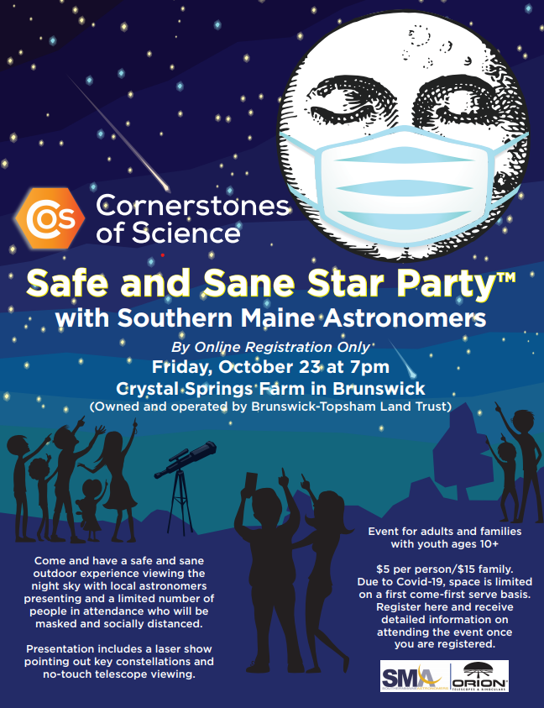
Join us for the next webinar on Wed. Oct. 21 at 2 p.m. to discuss Outdoor Library Programming

Slide 19
THANK YOU

